Slide 1


SAGE UNIVERSITY INDORE
INSTITUTE OF COMPUTER APPLICATION
PROJECT :- DEEP FACIAL RECOGNITION
BCA - iNurture
6th SEMESTER
PRESENTED BY :- Prateek Singh Kushwah (22COA2BCA0029)
Rudresh Rathod (22COA2BCA0024)
Mudar kasarawala (22COA2BCA0026)
GUIDED BY :- Prof. Rajni Chaturvedi Ma’am

Slide 2

DEEP FACIAL RECOGNITION APP

Slide 3


PROJECT BRIEFING: DEEP FACIAL RECOGNITION APP
PROJECT OVERVIEW: The Deep Facial Recognition App is a cutting-edge AI-powered application Designed to identify and verify individuals using deep learning techniques. The app leverages neuralNetwork to analyse facial features with high accuracy for various application.
OBJECTIVE: Developing a high-accuracy deep learning-based facial recognition application for various things like security
Authentication, identity verification, surveillance, ETC.
KEY FEATURES:
Real-time face detection & recognition – Instantly identify and verify individuals.
1:1 Face Verification – Authenticate a user by comparing a captured face with a stored image.
Multi-angle Recognition – Recognizes faces from different angles and lighting conditions.
Deep learning based feature extraction: Uses neural network to analyze facial features.

Slide 4

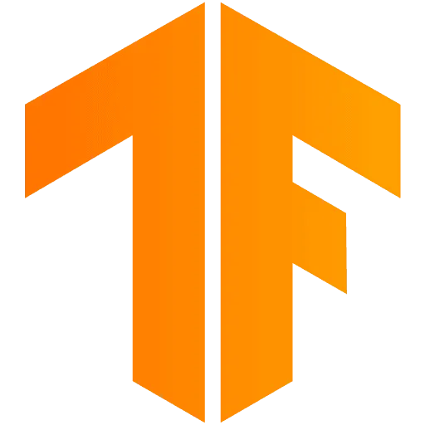

TOOLS & TECHNIQUES
Python
Python is used for web development, data science, machine learning, automation, and scripting. It powers AI, cybersecurity, game development, and IoT. With libraries like TensorFlow, Pandas, and Django, Python supports scalable applications in finance, healthcare, robotics, and cloud computing, making it a versatile programming language. Currently, we are using an older version of Python because tensorflow required Python 3.9 to 3.12 only.
Ver 3.12.8
Tensorflow
TensorFlow is used for deep learning, machine learning, and AI applications, including image recognition, NLP, reinforcement learning, and predictive analytics. It powers neural networks, automates data processing, and enables AI on mobile and edge devices. With GPU/TPU acceleration, TensorFlow supports scalable AI models in healthcare, finance, robotics, and more.
Ver 2.18
OpenCV
OpenCV is used for computer vision, image processing, and machine learning. It enables facial recognition, object detection, motion tracking, and augmented reality. With Python and AI integration, OpenCV supports robotics, medical imaging, surveillance, and automation in real-time vision-based applications

Slide 5

TOOLS & TECHNIQUES
Kivi
Kivy is a Python framework for building multi-touch applications and cross-platform GUIs. It supports Windows, macOS, Linux, Android, and iOS. Used in mobile apps, games, and interactive software, Kivy provides a responsive UI with features like gestures, animations, and OpenGL acceleration for smooth graphics and touchscreen interactions.

Slide 6




WORKFLOW
Setup tools, import dependencies and create directories.
collect data :- collect input images, negative and positive images.
preprocessing images, creating positive and negative samples.
create embedding and L1 distance layer.

Slide 7




WORKFLOW
Creating training step and training loop and training the model.
Testing the model.
Creating verification function and performing facial recognition in real time.
Creating a facial recognition app and integrating with tensorflow model.

Slide 8




WORKING OF NEURAL NETWORK
the distance layer calculates the difference between two face embeddings (numerical feature representations) using metrics like Euclidean distance or cosine similarity. A lower distance means higher similarity, helping classify faces accurately.
=
Input Image
Encoding Model
Very Simlar
Distance Layer
Here both the images are same/similar so it will have lower distance meaning higher similarities.
Positive Image
Encoding Model

Slide 9


WORKING OF NEURAL NETWORK
=
Input Image
Encoding Model
Not Simlar
Distance Layer
Here both the images are different so it will have higher distance meaning lower similarities.
Negative Image
Encoding Model

Slide 10
CONCLUTION
The development of a deep face recognition app demonstrates the power of artificial intelligence in identity verification and security. By leveraging deep learning models, particularly convolutional neural networks and frameworks like OpenCV, TensorFlow, the app can accurately detect and recognize faces in real time.

Slide 11
THANK YOU!

